Slide 1




Library Management System

Slide 2
Team Members
Aman Bhatt: Brick Bracker
Jeewan Kandpal: Library Management

Slide 3

Introduction
Greetings and Why We're Here
Hello, everyone! Today, we're talking about how we can make sure libraries work well. You know, find books easily and have a good time learning! Libraries are like treasure chests of knowledge, and we want to make sure they're super easy for everyone to use. So, let's dive in!

Slide 4


Importance of Library Management
Libraries are like big helpers for knowledge. They keep things organized so we can easily learn new stuff. Managing libraries well is super important. It's like taking care of a big store of information so that everyone can use it whenever they want. We're going to see why this matters so much.

Slide 5
Objective and Methodology:
Objective
Methodology
Our goal is to make libraries awesome places to find what you're looking for. We're going to learn about how to organize things, use cool technology, and make sure libraries are helpful for everyone. By the end, you'll know the secrets to making libraries work really well!.
We have used HTML and CSS for the designing part for Library Management.
For now there’s no backend

Slide 6
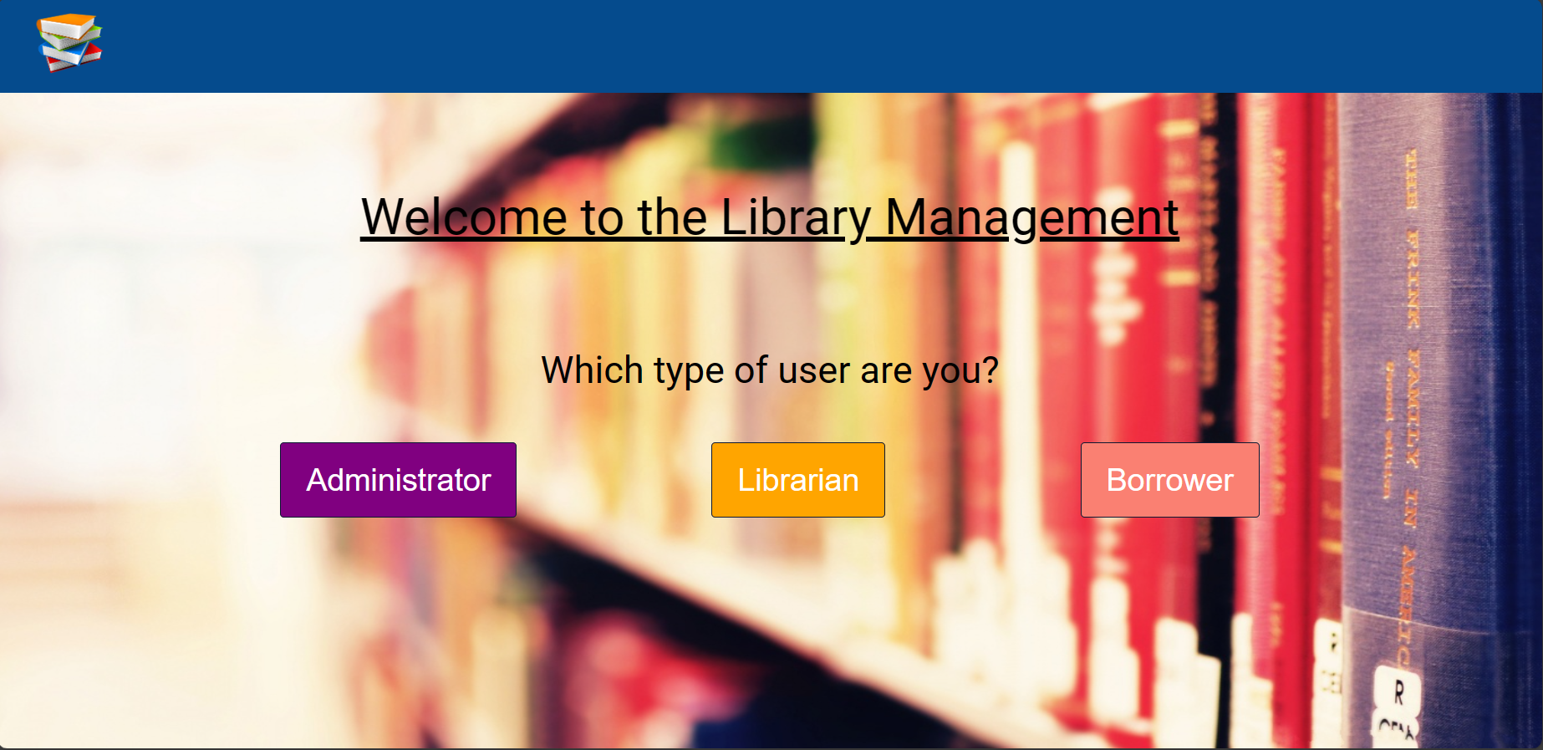
Project HOMEPAGE
There are three types of user login:
Administrator
Librarian
Borrower
Each one of them has their own Functionality

Slide 7


Results:
We have obtained a non functional Library Management System.
The system can perform various tasks and mark the books accordingly.

Slide 8

Overcoming Challenges
Libraries face challenges, but we have solutions! Whether it's not enough space, old systems, or tight budgets, there are creative ways to overcome these hurdles. Today, we'll discuss how libraries can adapt and find solutions to provide the best service to their users.

Slide 9

Conclusion
Celebrating the Future of Libraries
So, that's our trip through libraries! We've seen how they've changed from old times to now, and it's pretty cool. Libraries are not just about books; they're about people and technology working together.
Today, we learned about the different parts of a library, the awesome librarians who help us, and how technology is making things easier. We also talked about how libraries are not just quiet places but are lively hubs in our communities.
Looking ahead, the future of libraries is bright. They'll keep getting better with new tech and ideas. As long as libraries stay friendly, community-focused, and keep up with the times, they're here to stay, making sure everyone can enjoy and learn.
Thanks for being part of this library adventure! Let's cheer for libraries and the exciting things they'll bring in the future.

Slide 10
Brick Bracker

Slide 11
Introduction
Introduction to Brick Breaker
Brick Breaker is a super fun and simple game that has been around for ages. Imagine a wall of bricks at the top of your screen, and you have a paddle at the bottom. Your job is to bounce a ball off the paddle to smash those bricks. Sounds easy, right?

Slide 12
How it Works?
You control the paddle, making sure the ball doesn't slip past you. The trick is to aim the ball strategically to break as many bricks as possible. Each broken brick scores you points. It's a game of skill and quick reflexes!
What makes Brick Breaker awesome is its easy-to-grasp concept. Anyone can play, but mastering it is a whole other level of fun. The excitement comes from watching the ball zoom around, breaking bricks, and aiming for that high score.

Slide 13
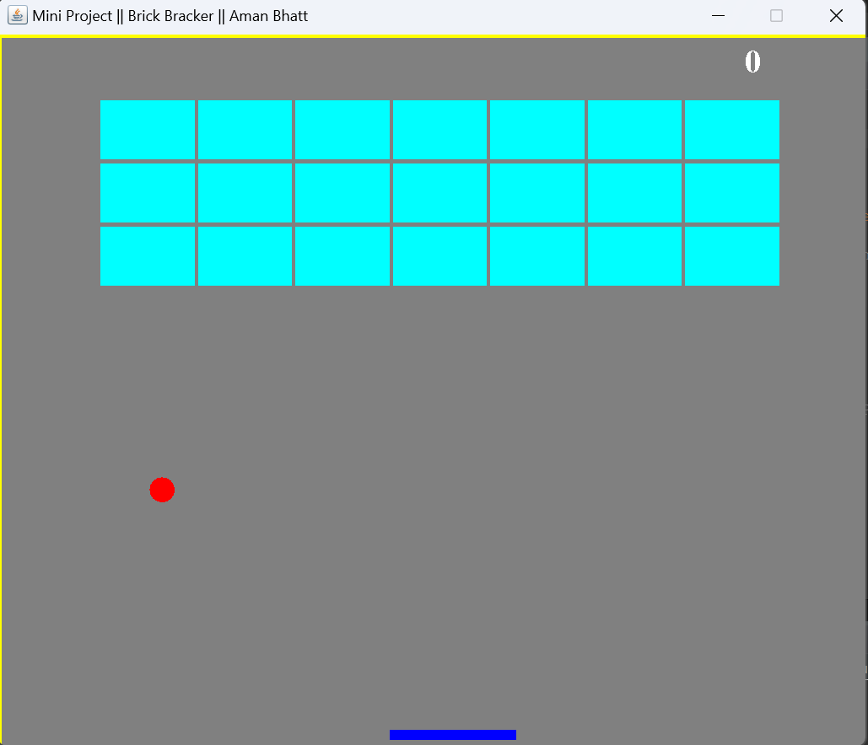
Project LAYOUT
You can control the paddle by using left arrow and right arrow key
We have used Java for this project, more precisely JFrame
Each time ball hits the bricks you will earn some points

Slide 14
Conclusion
Brick Breaker Adventure: The End, for Now
Alright, we've had a blast exploring the world of Brick Breaker! We've seen how it's a simple yet super cool game where you break bricks with a bouncing ball. Remember the paddle at the bottom? That's your secret weapon!
For now, it's time to wrap up our Brick Breaker adventure. Remember, the game might be over, but the fun never stops. Keep playing, keep coding, and who knows where your next adventure might take you!
Thanks for joining our Brick Breaker journey! Until next time—keep breaking those bricks and having a blast! 👾🧱🚀.

